Slide 1
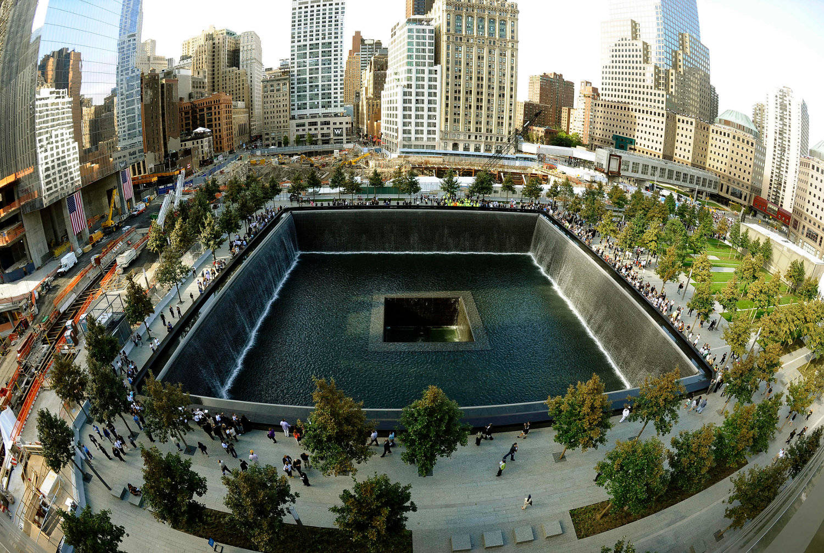
September 11, 2001
Mrs. Belof’s
History 20

Slide 2
On a clear, sunny Tuesday in September 2001, Al Qaeda terrorists aboard three hijacked passenger planes carried out coordinated suicide attacks against the World Trade Center in New York City and the Pentagon in Washington, D.C., killing everyone on board the planes and nearly 3,000 people on the ground.
A fourth plane crashed into a Pennsylvania field, killing all on board, after passengers and crew attempted to wrest control from the hijackers. Below is a chronology of the events of 9/11 as they unfolded. All times are Eastern Daylight Time (EDT).

Slide 3
8:13 am _____AA# 11 hijacked___________________________
8:43 am ____UA #175 hijacked_________________________
8:46 am ____AA #11 crashes north tower_______________________
8:51 am ____AA #77 hijacked____________________________
9:03 am ____UA #175 crashes into south tower____________________
9:28 am __UA #93 hijacked____________________________
9:37 am _____AA #77 crashes into the Pentagon________________
9:59 am ____WTC south collapses____________________________
10:03 am ___UA #93 Crashes in Shanksville PA_______________________
10:28 am_____WTC North tower collapses___________________

Slide 4
TIMELINE
7:59 am – American Airlines Flight 11, a Boeing 767 with 92 people aboard, takes off from Boston’s Logan International Airport en route to Los Angeles.
8:13 a.m.- An air controller instructs American 11 to climb to 35,000 feet, and the aircraft fails to respond. The controller tries using the emergency frequency to contact the aircraft but there is no response.
8:14 am – United Airlines Flight 175, a Boeing 767 with 65 people aboard, takes off from Boston; it is also headed to Los Angeles.
8:19 am – Flight attendants aboard Flight 11 alert ground personnel that the plane has been hijacked; American Airlines notifies the FBI.
8:20 am – American Airlines Flight 77 takes off from Dulles International Airport outside of Washington, D.C. The Boeing 757 is headed to Los Angeles with 64 people aboard.
8:21 a.m.- American Flight 11 turns off its transponder.
8:24 am – Hijacker Mohammed Atta makes the first of two accidental transmissions from Flight 11 to ground control (apparently in an attempt to communicate with the plane’s cabin).

Slide 5
8:24 a.m.: This transmission comes from American 11: "We have some planes. Just stay quiet, and you'll be okay. We are returning to the airport" ("We have some planes," was unintelligible.) Seconds later another statement follows: "Nobody move. Everything will be okay. If you try to make any moves, you'll endanger yourself and the airplane. Just stay quiet."
8:28 a.m.: The FAA's Boston Center calls FAA Command Center in Herndon, Virginia, and reports that American 11 has been hijacked.
8:34 a.m.: Boston Center receives another transmission from American 11: "Nobody move please. We are going back to the airport. Don't try to make any stupid moves."
8:37 a.m.: Boston Center informs NORAD of American 11's hijacking. It is the first notice the military receives of the unfolding events.
FAA: "Hi. Boston Center TMU, we have a problem here. We have a hijacked aircraft headed towards New York, and we need you guys, we need someone to scramble some F-16s or something up there, help us out."
NORAD: "Is this real-world or exercise?"
FAA: "No, this is not an exercise, not a test."

Slide 6
8:40 am – The Federal Aviation Administration (FAA) alerts North American Aerospace Defense Command (NORAD)’s Northeast Air Defense Sector (NEADS) about the suspected hijacking of Flight 11. In response, NEADS scrambles two fighter planes located at Cape Cod’s Otis Air National Guard Base to locate and tail Flight 11; they are not yet in the air when Flight 11 crashes into the North Tower.
8:41 a.m. - United 175 enters New York airspace.
8:41 am – United Airlines Flight 93, a Boeing 757 with 44 people aboard, takes off from Newark International Airport en route to San Francisco. It had been scheduled to depart at 8:00 am, around the time of the other hijacked flights.
8:46 am – In response to American 11's hijacking, Otis Air Force Base receives an order to scramble F-15s. Military officials ask for a destination for the fighter planes. None is known. Mohammed Atta and the other hijackers aboard American Airlines Flight 11 crash the plane into floors 93-99 of the North Tower of the World Trade Center, killing everyone on board and hundreds inside the building.

Slide 7
8:50 a.m.: The military receives word that a plane has hit the World Trade Center. At the same time, American 77 ceases communication with air traffic controllers.
8:47 am – Within seconds, NYPD and FDNY forces dispatch units to the World Trade Center, while Port Authority Police Department officers on site begin immediate evacuation of the North Tower. United 175 changes its transponder code twice. The changes go unnoticed because the same controller assigned to it is looking for American 11.
8:50 am – White House Chief of Staff Andrew Card alerts President George W. Bush that a plane has hit the World Trade Center; the president is visiting an elementary school in Sarasota, Florida at the time.
8:51 a.m.: The controller notices a change in the transponder code from United 175. The plane does not respond to repeated requests to change it back.

Slide 8
8:48 a.m.: The FAA's New York Center, unaware of American 11 crashing, talks to the FAA Command Center in a teleconference concerning that flight. "This is New York Center. We're watching the airplane...They've told us that they believe one of their stewardesses was stabbed and that there are people in the cockpit that have control of the aircraft..."
8:53 a.m.: Military fighter jets summoned for American 11 are airborne, but still lack a target and information about the threat. At the same time, the air traffic controller tells a peer there is a second hijacking and United 175 is unaccounted for. The controller begins diverting planes from the path of United 175.
8:54 a.m.: FAA Indianapolis air controllers notice American 77 deviating from its flight plan. The flight does not respond to contacts, and controllers are unaware of the hijacking and crash in New York.
8:56 a.m.: American 77 turns off its transponder.
9:00 a.m.: FAA Indianapolis notifies agencies that American 77 is missing, possibly crashed and seeks military help for a search and rescue.
9:01 a.m.: FAA New York Center notifies its command of its dilemma. "We have several situations going on here. It's escalating big, big time. We need to get the military involved with us."

Slide 9
9:02 am – After initially instructing tenants of the WTC’s South Tower to remain in the building, Port Authority officials broadcast orders to evacuate both towers via the public address system; an estimated 10,000 to 14,000 people are already in the process of evacuating.
9:02 a.m.: FAA New York Center asks New York's terminal approach for help in finding United 175.
Terminal: "I got somebody who keeps coasting, but it looks like he's going into one of the small airports down there. Got him just out of 9,500 -- 9,000 now."
Boston Center: "Do you know who he is?"
Terminal: "...We don't know who he is. We're just picking him up now."
Boston Center: "Heads up man, it looks like another one coming in."

Slide 10
9:03 a.m.: United Airlines Flight 175 crashes into the South Tower of the World Trade Center. FAA Boston Center deciphers the message from American 11, and realizes hijackers control more than one plane.
9:03 am – Hijackers crash United Airlines Flight 175 into floors 75-85 of the WTC’s South Tower, killing everyone on board and hundreds inside the building
9:08 a.m. til 9:13 a.m.: Military fighters are in a holding pattern over Long Island's coast. NORAD decides to ask the FAA to enter New York airspace as a defensive move. "... If this stuff is gonna keep on going, we need to take those fighters, put 'em over Manhattan. That's the best play right now.“
9:08 am – The FAA bans all takeoffs of flights going to New York City or through the airspace around the city.
9:09 a.m.: Fighter jets in Langley, Virginia, move to battle stations to backup New York fighters who may get low on fuel
9:10 a.m.: American 77 enters FAA Washington Center space but goes undetected for 36 minutes as the FAA checks westerly points for the craft.
9:17 a.m.: The Federal Aviation Administration shuts down all New York City area airports.
9:20 a.m.: FAA Indianapolis learns about the other hijackings and becomes suspicious about American 77.

Slide 11
9:21 am – The Port Authority closes all bridges and tunnels in the New York City area.
and FAA Command Center tells Dulles terminal to look for targets.
9:24 am – The FAA notified NEADS of the suspected hijacking of Flight 77 after some passengers and crew aboard are able to alert family members on the ground.
9:25 a.m.: The military establishes a combat air patrol over Manhattan, and the FAA issues a nationwide ground stop of all aircraft.
9:28 a.m.: The FAA receives its last normal communication from United 93.
9:29 a.m.: FAA Cleveland Control Center hears screams and struggles from an unknown source and someone yelling, "Get out of here! Get out of here!" The control center notices United 93 has dropped 700 feet.
9:30 a.m.: President Bush, speaking in Sarasota, Florida, says the country has suffered an "apparent terrorist attack." Cleveland Center polls other flights to determine if they heard the screaming at 9:29. Several report they did.
9:32 a.m.: Dulles terminal spots a suspicious aircraft and notifies the Secret Service. An unarmed National Guard cargo plane begins following American 77. Cleveland Center receives another transmission on the frequency from where there was screaming. "Keep remaining sitting. We have a bomb on board."

Slide 12
9:34 a.m.: FAA notified that United 93 might have a bomb on board. Until 10:08, Cleveland Center provides FAA updates on United 93's course.
9:36 a.m.: NORAD learns of a suspicious aircraft a few miles from the White House and orders the Langley fighter jets back to Washington. Cleveland Center asks whether anyone has requested military interception of United 93.
9:38 a.m.: American 77, with 58 passengers, four flight attendants and two pilots, crashes into the Pentagon, the National Guard pilot reports the crash to Washington's terminal facility; killing 59 aboard the plane and 125 military and civilian personnel inside the building. The Langley jets are 150 miles away.
9:39 a.m.: A radio transmission from United 93 crosses. It is the voice of hijacker Ziad Jarrah: "Uh, is the captain. Would like you all to remain seated. There is a bomb on board and are going back to the airport."
9:41 a.m.: FAA Cleveland Center loses United 93's transponder signal, but uses visual sightings from other planes to track its turn east, then south.
9:42 a.m.: FAA Command Center learns from television reports that a plane has struck the Pentagon. For the first time in history, the FAA grounds all flights over or bound for the continental United States. Some 3,300 commercial flights and 1,200 private planes are guided to airports in Canada and the United States over the next two-and-a-half hours.

Slide 13
9:45 am – Amid escalating rumors of other attacks, the White House and U.S. Capitol building are evacuated (along with numerous other high-profile buildings, landmarks and public spaces).
9:46 a.m.: Command Center notifies FAA headquarters that United 93 was 29 minutes away from Washington, D.C.
9:49 a.m.: FAA Command Center addresses Cleveland's 9:36 request to seek military intervention of United 93.
Command Center: "Uh, do we want to think about, uh, scrambling aircraft?"
FAA Headquarters: "Uh, God, I don't know."
Command Center: "Uh, that's a decision somebody's gonna have to make probably in the next 10 minutes."
9:57 a.m.: Bush departs Florida for Barksdale Air Force Base in Louisiana.

Slide 14
9:59 am – The South Tower of the World Trade Center collapses.
10:01 a.m.: Command Center tell FAA headquarters that another aircraft had seen United 93 "waving his wings." It's believed to be evidence of the passengers' efforts to overpower the hijackers.
10:03 a.m.: United Airlines Flight 93, en route from Newark, N.J., to San Francisco with 38 passengers, two pilots and five flight attendants aboard, crashes about 60 miles southeast of Pittsburgh. After passengers and crew members aboard the hijacked Flight 93 contact friends and family and learn about the attacks in New York and Washington, they mount an attempt to retake the plane. In response, hijackers deliberately crash the plane into a field near Shanksville, Pennsylvania, killing all 40 passengers and crew aboard.
10:10 a.m.: Part of the Pentagon collapses.
10:13 a.m.: The 39-story United Nations building is evacuated. A total of 11,700 people were evacuated "as a precautionary measure," a U.N. spokeswoman said
10:24 a.m.: The FAA announces that all inbound trans-Atlantic aircraft into the United States are being diverted to Canada.
10:28 am – The World Trade Center’s North Tower collapses, 102 minutes after being struck by Flight 11.

Slide 15
11 am – Mayor Rudolph Giuliani calls for the evacuation of Lower Manhattan south of Canal Street, including more than 1 million residents, workers and tourists, as efforts continue throughout the afternoon to search for survivors at the WTC site.
11:18 a.m.: American Airlines says it has lost two planes. The airline says American Flight 11, a Boeing 767, en route from Boston to Los Angeles, and Flight 77, a Boeing 757 flying from Dulles Airport to San Francisco, had crashed.
11:26 a.m.: United Airlines announces the crash of United Flight 93 southeast of Pittsburgh. 11:59 a.m.: United Airlines confirms that Flight 175 has crashed with 56 passengers and nine crew members aboard.
1 pm – From a U.S. Air Force base in Louisiana, President Bush announces that U.S. military forces are on high alert worldwide. He asks for prayers for those killed or wounded in the attacks. "Make no mistake, the United States will hunt down and punish those responsible for these cowardly acts," he said
2:51 pm – The U.S. Navy dispatches missile destroyers to New York and Washington, D.C.
5:20 pm – The 47-story Seven World Trade Center collapses after burning for hours; the building had been evacuated in the morning, and there are no casualties, though the collapse forces rescue workers to flee for their lives.
6:58 pm – President Bush returns to the White House after stops at military bases in Louisiana and Nebraska.
8:30 pm – President Bush addresses the nation, calling the attacks “evil, despicable acts of terror” and declaring that America, its friends and allies would “stand together to win the war against terrorism.”

Slide 16
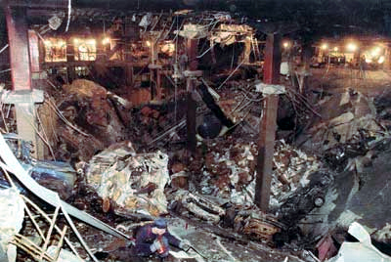

Slide 17
WTC BOMBING 1993
September 11, 2001 was not the first time the WTC was attacked by terrorists. Here's some background information about the 1993 World Trade Center Bombing which killed six people and injured more than 1,000. Six suspects were convicted of participating in the bombing. The seventh suspect, Abdul Rahman Yasin, remains at large.
Facts:
The explosion created a hole 200 feet by 100 feet, several stories deep. It caused the PATH station ceiling to collapse.
The 1,200 lb bomb was in a Ryder truck parked in a parking garage beneath the World Trade Center.
An estimated 50,000 people were evacuated.
Ramzi Youssef directed the organization and execution of the bombing. He said he did it to avenge the sufferings Palestinian people had endured at the hands of U.S.-aided Israel.

Slide 18
Abbreviated Timeline:
February 26, 1993 - At 12:18 pm, a bomb explodes on the second subterranean level of Vista Hotel's public parking garage, below the 2 World Trade Center building.
February 28, 1993 - The FBI confirms that a bomb caused the explosion. In the wreckage, federal agents find shattered van parts with a vehicle identification number.
March 4, 1994 - Four defendants, Mohammed Salameh, Nidal Ayyad, Mahmud Abouhalima, and Ahmad Ajaj,are convicted. They are sentenced to prison terms of 240 years each. In 1998, the sentences are vacated. In 1999, the men are re-sentenced to terms of more than 100 years.
February 7, 1995 - Suspected WTC bombing mastermind Ramzi Ahmed Youssef is captured abroad by the FBI and State Department.
January 8, 1998 - After being convicted, Ramzi Youssef is sentenced to 240 years in prison for his role in organizing the bombing. "I am a terrorist and proud of it," he tells the court.

Slide 19
After Youssef was arrested in Pakistan he was quickly extradited to the United States. After he arrived in New York, FBI agents drove him by the World Trade Center and said, "See, it's still standing." He reportedly said, "If I had a little more money, it wouldn't be." Two Americans were killed soon after the extradition in what was believed to be a revenge killing. Youssef was tried and convicted in the United States and was sentenced to life in prison for masterminding the 1993 World Trade Center bombing. After the sentencing he said, "Yes, I am a terrorist and proud of it." He is now serving a life sentence at a prison in Colorado.

Slide 20
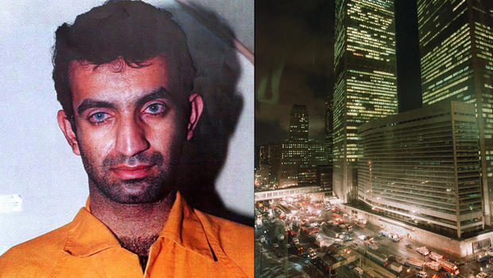

Slide 21
What was Ramzi’s Connection to 9/11?
Ramzi Youssef was the mastermind of the 1993 attack on the World Trade Center
Youssef had links with Al-Qaeda but was regarded as a freelancer.
Even so he is credited with making Al-Qaeda a worldwide terrorist network.
He hatched a plan to fly planes full of explosives in the CIA building and nuclear power plants. Some regard these as blueprints for the attack on the World Trade Center in New York on September 11, 2001. Many believe that if the CIA and the FBI took this plot more seriously September 11th could have been avoided.
**** He is the nephew of Khalid Shailkh Mohammed (KSM) *****

Slide 22
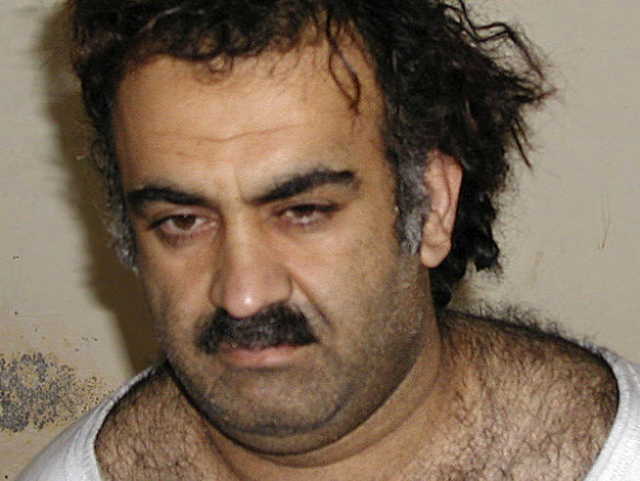

Slide 23
Who is KSM?
Nicknamed the “Kevin Bacon of terrorism.
Nearly every major plot leveled against the United States from 1990 until years after the 2001 attacks had fewer than six degrees of separation from KSM. Either his family was involved, or his financing network coaxed something along, or he himself played a key role.
His nephew Ramzi Youssef dreamed up the 1993 World Trade Center bombing.
A KSM intimate partly financed the nightclub bombings in Bali, Indonesia. And the early reconnaissance for a 1995 plot to blow up a dozen American-flagged jetliners over the Pacific, according to McDermott and Meyer, was done by KSM himself.

Slide 24
In his testimony to a military tribunal at Guantanamo Bay, Mohammed claimed involvement in 31 attacks and plots.
He was the mastermind of the 9/11 jetliner attacks and, in their wake, certified his bloodthirst by personally beheading Wall Street Journal reporter Daniel Pearl---bragging about it on the Internet then and in the testimony transcript."."I decapitated with my blessed right hand the head of the American Jew, Daniel Pearl, in the city of Karachi, Pakistan," he said. "For those who would like to confirm, there are pictures of me on the Internet holding his head?.".
His operations ranged from his admitted involvement in the 1993 attack on the World Trade Center, as well as a failed scheme known as Bojinka to bring down 12 Western airliners in Asia---claims that are well documented. Less certain is his claimed role in the October 2002 bombings that killed 202 people in Bali, Indonesia, and aborted plots to assassinate former U.S. presidents and Pope John Paul II. [Source: AP, March 16, 2007
Sounds like a real great guy, huh?

Slide 25
The 9/11 Commission Report, discussing Mohammed's terrorist ambitions, called him a "self-cast star." "I am the mastermind of 9/11, not Osama bin Laden," he said in one court hearing. "I know him well, and if he gets his way in federal court, it will be a circus,"
Dina Temple-Raston wrote in the Washington Post: “When the Red Cross visited him for the first time after his 2003 capture, KSM didn't want to talk about waterboarding or the conditions of his confinement. Instead, his top priority was a photo shoot. He wanted the Red Cross to release a portrait of him with a proper long beard. Evidently, the picture released shortly after his capture (more about that later)---all threadbare T-shirt and wild hair---was driving him crazy." [Source: Dina Temple-Raston, Washington Post , June 8, 2012]
Terry McDermott wrote in The New Yorker: “Insofar as we know Mohammed, we see him as a brilliant behind-the-scenes tactician and a resolute ideologue. As it turns out, he is earthy, slick in a way, but naïve, and seemingly motivated as much by pathology as by ideology. Fouda describes Mohammed's Arabic as crude and colloquial and his knowledge of Islamic texts as almost nonexistent [Source: Terry McDermott, The New Yorker, September 13, 2010]
In at least one important way, though, his boasts are accurate. Mohammed, not Osama bin Laden, was the essential figure in the 9/11 plot. The attacks were his idea, carried out under his direct command. Mohammed has said that he went so far as to resist swearing allegiance to bin Laden and Al Qaeda until after the attacks, so that he could continue pursuing them if Al Qaeda lost courage."

Slide 26
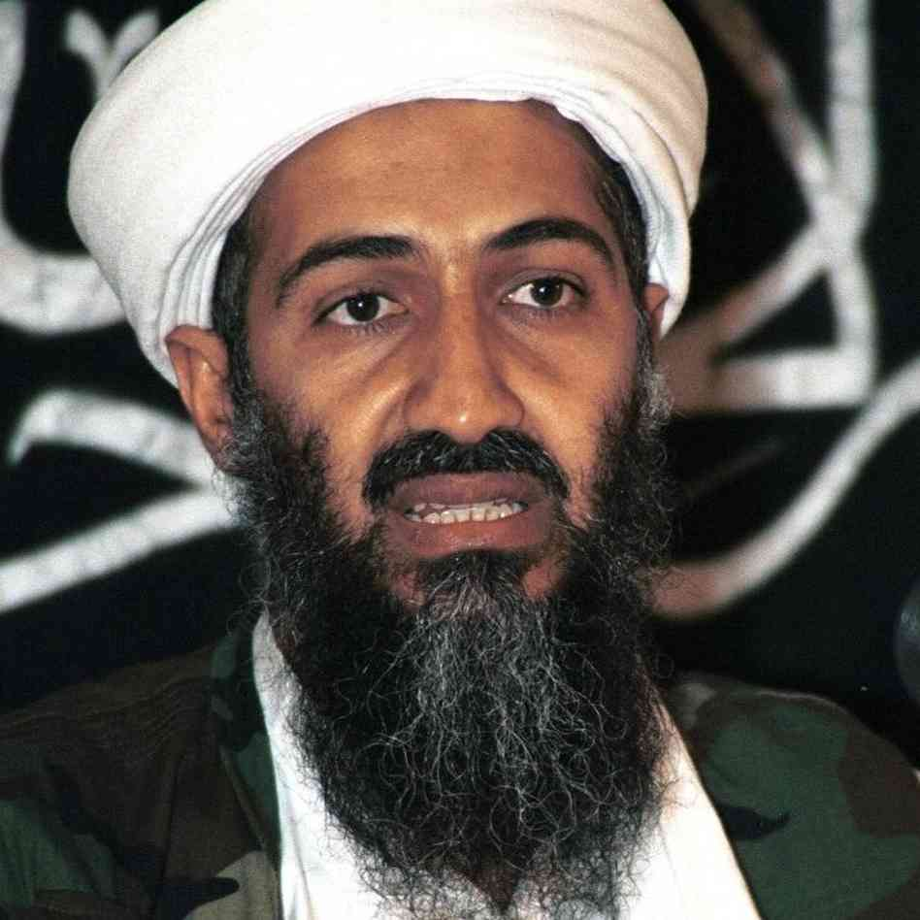

Slide 27
Osama bin Laden
On May 1, 2011, American soldiers killed al-Qaeda leader Osama bin Laden at his compound near Islamabad, Pakistan. Intelligence officials believe bin Laden was responsible for many deadly acts of terrorism, including the 1998 bombings of the U.S. Embassies in Kenya and Tanzania and the September 11, 2001 attacks on the Pentagon and the World Trade Center. He had been on the FBI’s “most wanted” list for more than a decade.
Osama bin Laden was born in Riyadh, Saudi Arabia in 1957 or 1958.
He was the 17th of 52 children born to Mohammed bin Laden, a Yemeni immigrant who owned the largest construction company in the Saudi kingdom and was a billionaire
Young Osama had a privileged upbringing. His siblings were educated in the West and went to work for his father’s company (by then an enormous conglomerate that distributed consumer goods like Volkswagen cars and Snapple beverages across the Middle East), but Osama bin Laden stayed close to home.
He went to school in Jiddah, married young and, like many Saudi men, joined the Islamist Muslim Brotherhood.

Slide 28
For bin Laden, Islam was more than just a religion: It shaped his political beliefs and influenced every decision he made.
While he was at college in the late 1970s, he became a follower of the radical pan-Islamist scholar Abdullah Azzam, who believed that all Muslims should rise up in jihad, or holy war, to create a single Islamic state.
This idea appealed to the young bin Laden, who resented what he saw as a growing Western influence on Middle Eastern life.
In 1979, Soviet troops invaded Afghanistan; soon afterward, Azzam and bin Laden traveled to Peshawar, a Pakistani city on the border with Afghanistan, to join the resistance.
They did not become fighters themselves, but they used their extensive connections to win financial and moral support for the mujahideen (the Afghan rebels).
They also encouraged young men to come from all over the Middle East to be a part of the Afghan jihad. Their organization, called the Maktab al-Khidamat (MAK) served as a global recruitment network–it had offices in places as far away as Brooklyn and Tucson, Arizona–and provided the migrant soldiers, known as “Afghan Arabs,” with training and supplies. Most important, it showed bin Laden and his associates that it was possible to put pan-Islamism into practice.

Slide 29
In 1988, bin Laden created a new group, called al-Qaeda (“the base”) that would focus on symbolic acts of terrorism instead of military campaigns.
After the Soviets withdrew from Afghanistan in 1989, bin Laden returned to Saudi Arabia to step up fundraising for this new and more complicated mission.
But, the pro-Western Saudi royal family feared that bin Laden’s fiery pan-Islamist rhetoric might cause trouble in the kingdom, and so they tried to keep him as quiet as they could.
They took away his passport and spurned his offer to send “Afghan Arabs” to guard the border after Iraq invaded Kuwait in 1990.
Then, adding insult to injury, Saudi Arabia sought help from the “infidel” U.S. instead.
Furious about being snubbed, bin Laden vowed that it was al-Qaida, and not the Americans, who would one day prove to be “master of this world.”

Slide 30
* bin Laden was forced out of Saudi Arabia and went to Sudan.
After one more year of preparation, al-Qaeda struck for the first time: A bomb exploded in a hotel in Aden, Yemen, that had housed American troops on their way to a peacekeeping mission in Somalia. (No Americans died in the blast, but two Austrian tourists did.) They trained and armed the Somali rebels who killed 18 American servicemen in Mogadishu in 1993. They were also linked to the 1993 bombing of New York’s World Trade Center; the attempted assassination of Egyptian president Hosni Mubarek in 1995; the bombing of a U.S. National Guard training center in Riyadh that same year; and the truck bomb that destroyed the Khobar Towers, an American military residence in Dharan, in 1996.
In an attempt to protect himself from arrest and win even more recruits to al-Qaida’s deadly cause, bin Laden moved from Sudan to Afghanistan in 1996.
Meanwhile, the scale of al-Qaida’s attacks continued to increase. On August 7, 1998, bombs exploded simultaneously at the U.S. Embassies in Nairobi, Kenya, where 213 people were killed and 4,500 were injured, and Dar-es-Salaam, Tanzania, where 11 people were killed and 85 were injured. Al-Qaida took credit for the bombings.
Then, on October 12, 2000, a small boat loaded with explosives plowed into the hull of the U.S.S. Cole, an American naval destroyer docked off the coast of Yemen. 17 sailors were killed and 38 were injured. Bin Laden took credit for that incident as well.

Slide 31
A federal grand jury in the United States indicted bin Laden on charges related to the embassy bombings, but with no defendant there could be no trial.
Meanwhile, al-Qaida operatives were busy planning the biggest attack of all: the September 11, 2001 attacks on the World Trade Center and the Pentagon
Even in the frenzy of the post-September 11 “global war on terror,” bin Laden eluded capture.
For almost ten years, he remained in hiding, issuing fatwas and taunts over radio and television, recruiting enthusiastic young jihadis to his cause and plotting new attacks.
Meanwhile, the CIA and other intelligence officials searched in vain for his hiding place.
Finally, in August 2010, they traced bin Laden to a compound in Abbottabad, Pakistan, about 35 miles from Islamabad. For months, CIA agents watched the house while drones photographed it from the sky
May 2 (May 1 in the US and Canada) they found the al-Qaida leader in an upstairs bedroom with a pistol and an assault rifle nearby and shot him in the head and chest, killing him instantly
Bin Laden’s body was evacuated from the Abbottabad compound by helicopter and flown to an American aircraft carrier in the Indian Ocean. The corpse was buried at sea.

Slide 32
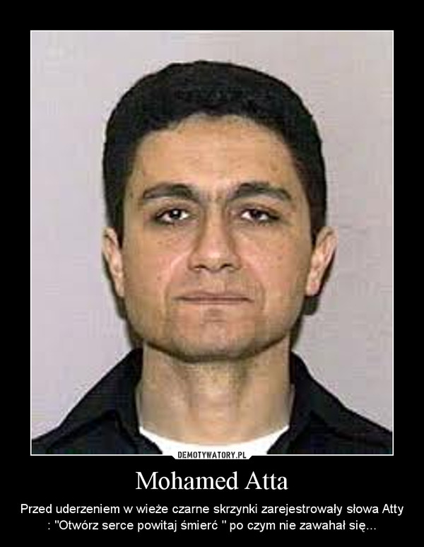

Slide 33
Mohammed Atta
an Egyptian hijacker and one of the ringleaders of 911
served as the hijacker-pilot of AA flight 11, crashing the plane into the North Tower of the WTC
At 33 years of age, he was the oldest hijacker who had participated in the attacks
The 9/11 Commission Report says that Mohamed Atta (along with Marwan al-Shehhi, Ramzi Binalshibh, and Ziad Jarrah who all became what is known as the Hamburg Cell) flew to Pakistan in November 1999 where they met Osama bin Laden in Kandahar.
bin Laden asked them to pledge loyalty and commit to suicide missions, which Atta and the other three Hamburg men all accepted.
bin Laden sent them to Karachi to see Khalid Sheikh Mohammed (KSM) to get a general overview of the planes operation
Atta previously attended the Technical University of Hamburg where he studied in urban planning. He often criticized the modern skyscrapers and thought they were disrupting the fabric of ancient cities by blocking community streets and altering the skyline

Slide 34
Atta and another hijacker arrived in the United States in June 2000.
They went to Venice, Florida and entered the Accelerated Pilot Program at Huffman Aviation
Atta and Shehhi obtained instrument ratings in November 2000, and continued training on simulators and flight training.
Beginning in May 2001, Atta assisted with the arrival of the muscle hijackers.
In July 2001, Atta traveled to Spain where he met with bin al-Shibh to exchange information and finalize the plot.
In August 2001, Atta traveled as a passenger on several "surveillance" flights, to establish in detail how the attacks could be carried out.
In early September 2001, Atta traveled to Maryland to meet Hani Hanjour, another hijacker
Atta then traveled to Boston, and on September 10, with fellow hijacker Abdulaziz al-Omari, went to Portland, Maine.
They spent the night at the Comfort Inn in South Portland. On the morning of September 11, Atta and Omari traveled on Colgan Air back to Boston, where they boarded AA flight 11.
Fifteen minutes into the flight, the team of hijackers attacked and Atta took over control of the aircraft.
At 8:46 am, Atta crashed the Boeing 767 into the North Tower of the World Trade Center

Slide 35
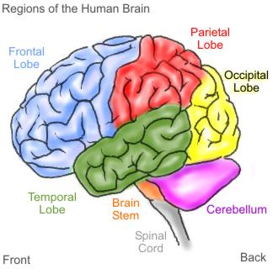
Summary of Key Players
Mastermind/ Brains =
Financing/money = Osama bin Laden
Muscle = Mohammed Atta
Khalid Shailkh Mohammed (KSM)

Slide 36
The Ground Truth
The following info was taken from John Farmer’s book, THE GROUND TRUTH- senior council to the 911 Commission
Throughout the 911 Commission’s investigation into the events of 911, many discrepancies are evident, not about the events themselves, but in the Governments misleading comments about the reactions of the various Government agencies involved in the response to the events of that day.
In the grand scheme of things the Government’s deception about how the US defended the country on 911 may seem minor, however, the Government’s failure to tell the whole truth had far-reaching effects (most notably, adding fuel to the fire of many conspiracy theorists)
What the 911 Commission uncovered was the deception lies in the Government’s overstatement of the efficiency and effectiveness of the US’s national response. It uncovered a radical disconnect between those who are in charge of the country’s defence and those employees who were on the ground making operational decisions, as well as the lack of cooperation between already established Government agencies. It also uncovered flaws in the defence system that were never updated in the post Cold-War era to address new terrorist threats.
The response was to create a new Government bureaucracy, The Department of Homeland Security, instead of “fixing” the way bureaucracies function. The failure to fix the underlying issues became glaringly obvious in 2005, during Hurricane Katrina. The problems the government encountered responding to Katrina mirrored, and in many cases replicated, the problems experienced on 911.

Slide 37
The essential truth is that the US failed to “reinvent government” to adapt to the challenges of a New World Order after the Cold-War era.
The Cold War did not end in 1991; for all practical purposes, it did not end until 9:03 on September 11 when United Airlines 175 (the second hijacked plane) crashed into the second tower. Only then did it become obvious that America was under attack.
It uncovered that for all the technology and advancements in national defence, the US was still using an antiquated system focused on Russia with antiquated radar scopes and other equipment

Slide 38
How did the key players plan 911?
1996-1997- two men in a cave
In mid 1996 in a cave in Tora Bora, Afghanistan, two men, Osama bin Laden and Khakid Sheikh Mohammed (KSM), met to discuss potential attacks against the US
These men met briefly in the 1980’s during the Soviet occupation of Afghanistan (we will discuss the significance of this occupation a bit later!), but their paths were independent of each other until this 1996 meeting
bin Laden came to his willingness to attack the US gradually. Originally his focus was on the Soviets, but then shifted to overthrowing the “Secular Arab governments” before “further away enemies” like Israel and the US were to be tackled. Because he spoke out against Arab governments (especially the Saudi government for their ties to the US), he was “kicked out” of Saudi Arabia in 1991 and moved his base to Sudan

Slide 39
Bin Laden used Sudan as a base from 1992-1996
During this time al Qaeda became increasingly confrontational with the US (bombing two hotels in Aden where US military was dan as his known to stay, supported the Somali warlords who shot down two US Black Hawk helicopters in 1993 etc- see earlier slides on Bin Laden)
Bowing to pressure from the US, the Sudanese government expelled bin Laden in 1996.
Bin Laden then moved his al Qaeda base of operation to Afghanistan in 1996
Bin Laden determined the main enemy was the US because they had too much influence over the secular Arab governments. He figured if the US was beheaded, attacked and overthrown, the Arab kingdoms would “wither away” and he would be primed to rule the Arab world.
It was with this mindset that the two men met in the cave in 1996
KSM came armed to the meeting with the knowledge and lessons learned from his nephew’s (Ramzi Youssef) failed plots, including the 1993 WTC bombing and the so-called Bojinka Plot
This plot involved blowing up of 12 commercial airliners over the Pacific Ocean over a 2 day period- Youssef had all the explosives and had even tested one of the bombs on a Philippine airliner en route to Tokyo- killing the passenger under whose seat Youssef planted the bomb
The plot was foiled when Manila authorities discovered the bomb-making laboratory when it accidentally exploded

Slide 40
KSM claims he had no official allegiance to bin Laden or al Qaeda prior to this 1996 meeting
Bin Laden was non-committal and less than enthusiastic with KSM’s plot ideas because of all the players it would take (that had to keep their mouths shut for years) as well as it required staying undetected by the multilevel security of the US both on the homeland and abroad
By 1996 the US was the undeniable single global superpower, and that superpower possessed the most extensive arsenal, the greatest number of military bases around the world, the most sophisticated signals intelligence system, and the greatest system of law enforcement detection.
Any proposed attack using airliners would have to get around all systems of intelligence, national defence and law enforcement… CIA, FBI, DoD, INS, FAA, NORAD, NEADS, NSA, DIA, NRO etc (look these up to make sure you know what is what!!!)… not to mention it would take an extraordinary amount of money!

Slide 41
US Intelligence
By 1996 the CIA was actively collecting evidence on bin Laden and even created a counterterrorist center (a special “station”) of about a dozen officers focused on learning about his background, intentions, movements and capabilities
It was the first time in history that an Agency station’s mission targeted a person rather than a country
The “bin Laden station” was located in Langley, Virginia, a short distance from CIA headquarters
By 1997 the US had recruited Afghan tribal fighters, Pakistani intelligence and other tribal leaders to give “real time” intelligence on bin Laden and his whereabouts so the US DELTA FORCE (created in 1977 as a highly trained rapid-response team that can deploy virtually anywhere in the world) could capture or kill bin Laden

Slide 42
Failed Attempts to Capture bin Laden
In February 1998, bin Laden held a press conference and issued a fatwa “kill and fight Americans and their allies, whether civilians or military, is an obligation for any Muslim who is able to do so in any country”
He accused the US of, “occupying the most sacred lands of Islam: the Arabian Peninsula. It has been stealing resources, dictating to its leaders, humiliating its people, and frightening its neighbours. It is using its rule in the Peninsula as a weapon to fight the neighbouring peoples of Islam.”
Because of this fatwa, the counterterrorist center formulated an elaborate plan to kidnap bin Laden while he slept at Tarnak Farms, his complex in the outskirts of Kandahar
May 20, 1998 the kidnap plan went into a 4 day trial dry-run. The plan was then reviewed by the commander of Delta Force who put the success rate of about 50%. The director of the CIA scrapped the plan
August 20, the White House reviewed and rejected a Pentagon plan for a special forces raid in Afghanistan, instead the President decided to launch 75 Tomahawk cruise missiles. More than 20 jihaddists were killed, but bin Laden and other al Qaeda leaders were not there

Slide 43
In September, the White House rejected another missile attack at Tarnak Farms, but signed an executive order authorizing the freezing of any assets that could be linked to bin Laden
Bin Laden responded by increasing the number of his personal body guards and took to moving frequently, sleeping in a different location each night as well as escalading his jihad against the US by offering a 9 million dollar reward for the assassination of the US Secretary of State, the Secretary of Defence, the FBI Director or the CIA Director
In late 1998 or early 1999 he met again with KSM and told him to go forward with the planes operation
On December 4, 1998 President Clinton’s daily briefing was headlined with, “bin Laden Preparing to Hijack US Aircraft and Other Attacks”
Two weeks later, On December 20, the CIA received intelligence that bin Laden would be at the governor’s residence in Kandahar. The CIA’s station chief said, “hit him tonight-we may not get another chance”, but the national security team decided against it for fear of collateral damage

Slide 44
The US government thought they had bin Laden when they received intelligence that bin Laden was staying in a hunting camp in western Afghanistan
The CIA and NIMA (National Imagery Mapping Agency) located and thoroughly mapped the site, but it showed that bin Laden appeared to be a guest of sheikhs from the UAE
President Clinton (who was facing impeachment at the time of this briefing) scrapped the mission as the UAE were an important ally to the US and he couldn’t risk the sheikhs getting hurt or killed in the strike
A month later, KSM was summoned to Kandahar and instructed by bin Laden to pursue the planes attack but to scale it down. The original plan (according to KSM-reveled during interrogation) included a total of 10 planes, 9 of which would crash into targets on both coasts and the 10th, flown by KSM himself, would land the plane at a US airport, kill all male passengers, and deliver a speech condemning US support for Israel, the Philippines, and repressive governments in the Arab world.
The final plan was refined and scaled back during a series of meetings in a complex called al Matar, near Kandahar in the spring of 1999.
In May of 1999 over a 5-day period the US had 3 opportunities to fire on bin Laden, but the White House was not convinced of the competence of the CIA intelligence, and thus, never issued a missile attack

Slide 45
More blunders….
By the fall of 1999 the emphasis went from proactively trying to capture/kill bin Laden to defensive activation of every layer of national security
The CIA’s Counterterrorist Center picked up multiple signs that bin Laden had set in motion major terrorist attacks timed to the turn of the year, although this again was treated with skepticism from the White House
However, when Jordanian intelligence disrupted a plot to bomb a Radisson Hotel on New Year’s Eve and a random customs check by a Canadian Border Patrol yielded the arrest of an al Qaeda operative who had intended to bomb LAX (Los Angeles International airport), by mid December the US was on high alert
A record number of Foreign Intelligence Surveillance Act wiretaps were ordered, foreign embassies and CIA operatives were told to arrest anyone with ties to Bin Laden and al Qaeda law enforcement in New Jersey were briefed on emergency plans if Manhattan was attacked. But when no attacks occurred on US soil in 2000, the powers that be relaxed

Slide 46
Despite the heightened state of alert, many events were missed:
No one picked up a failed attack in Yemen where a team of al Qaeda intended to bomb a US Navy ship, but had sunk their own boat when they overfilled it with explosives
Not even German intelligence reported the curious travel in late November of 4 students in Hamburg to Pakistan and Afghanistan. This group, known as the Hamburg group, was led by Mohammed Atta and formed the core of the 911 hijackers. The trip had been hidden to the German authorities by their friends, and as a result, no intelligence regarding travel of these four hijackers was collected or passed on to the US. As a result, the enormous early warning apparatus of the US National Security system was successfully bypassed
The other hijacking team was not as fortunate. During the FBI’s investigation of the embassy bombing they found a phone number in Yemen that appeared to be an al Qaeda clearing house for al Qaeda phone messages. The father in law of one of the hijackers was now being monitored by the NSA
Through this, the NSA picked up intelligence of a meeting in January 2000 in Kuala Lumpur, Malaysia
CIA agents tracked Midhar (one of the hijackers) to Dubai (en route to Malaysia), broke into his hotel room and photographed his passport- showing he had a multi-entry US visa
They faxed this to the CIA’s Counterterrorist Center, which notified intelligence services throughout the world

Slide 47
The CIA requested that Malaysian intelligence provide surveillance of the meeting which was held Jan 5, 2000
The Malaysian authorities did “watch” the behaviours and take pictures, but did not wire tap the room
The CIA Counterterrorist Center did notify the FBI of Mihdhar’s American visa and wrote a request asking to share the information about the meeting in Kuala Lumpur and the possibility that one or more of the participants would be travelling to the US. The FBI responded that “this is not a matter for the FBI”
Thus, on Jan 8, 2000 Mihdhar, Hazmi and a third hijacker flew from Kuala Lumpur to Bankok were they were lost to surveillance
4. In March 2000 Bankok’s CIA station reported Hamzi flew into the US on January 15 on a United Airlines flight, but no one outside the Counterterroist Center was notified
5. When the bombing of USS Cole occurred, interest in Mihdhar was renewed as the USS Cole bomber Khallad had been photographed with him at the meeting in Kuala Lumpur. But since there were no wiretaps, all intelligence about the USS Cole and the 911 attacks were lost
6. By the end of June 2000 three of the four 911 pilots were safely in the US being trained to fly by US flight schools (KSM’s nephew Ramzi Youssef- remember him???- paid for the flight training of all three of these hijackers)
7. The 4thpilot (Hani Hanjour) lived in the states off an on throughout the 1990’s and was already trained as a pilot. December 8, 2000 Hanjour arrived in San Diego

Slide 48
Clinton’s Major Blunder…
Even though it was clear that the bombing of the USS Cole was an al Qaeda operation, it remained officially as an “unproven assumption” and since the US Presidential election was also under way at this time, President Clinton told the 911 Commission that he would have given the order to move on the Taliban and al Quada, but thought it would be “irresponsible” for a president to launch an attack on another country based on “preliminary judgement”.
This, as you can imagine, frustrated the heck out of the CIA Counterterrorist Center who knew they had given more than enough evidence proving the link to al Qaeda
Here’s the thing… if the order had really been given back in 1998 to capture or kill bin Laden then why was the White House now looking for “specific proof” before moving on bin Laden?

Slide 49
Why did they chose the targets they did?
As you now know, the original scope of the attack was scaled back. Why the WTC? Why the Pentagon? Why the Washington Capitol building?
These terrorists wanted to “destroy the head of the snake”, essentially wanted to destroy the US and make the country collapse into ruin. How do you do this? Simply put, you destroy the three things that keep a country a superpower… hit them financially, politically and militarily.
WTC- center of US economy including the NYSE (having FBI/ATF headquarters there was also a
bonus)
Pentagon- center of US military power
Washington Capitol- center of US Government power

Slide 50
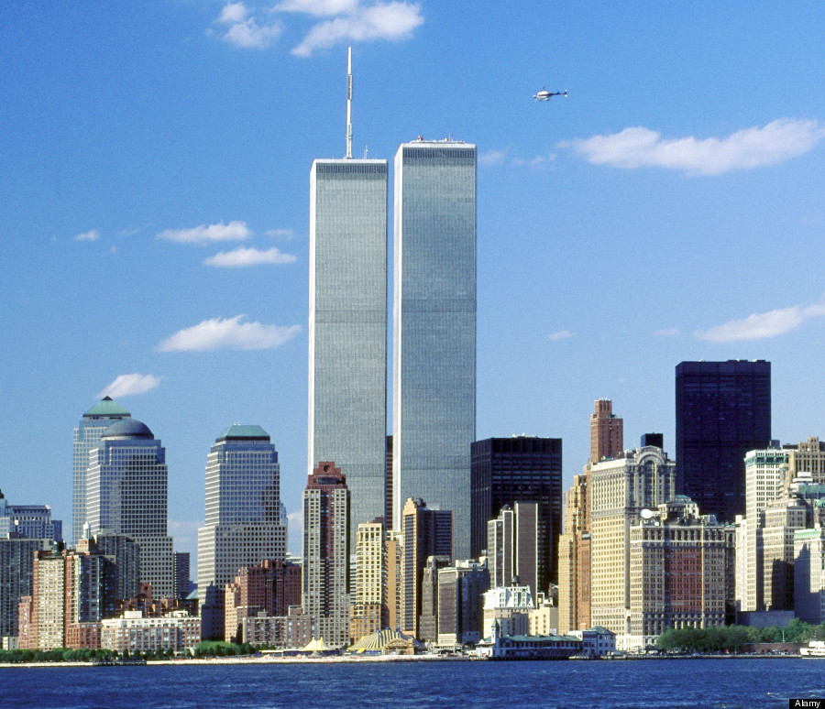

Slide 51
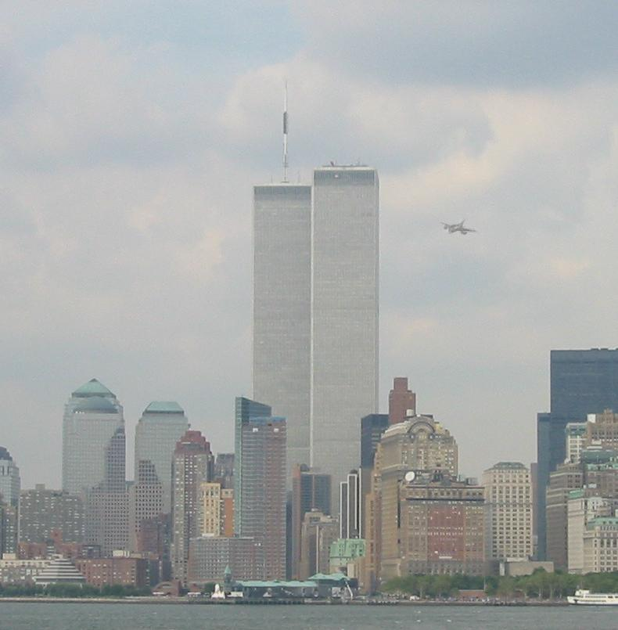

Slide 52
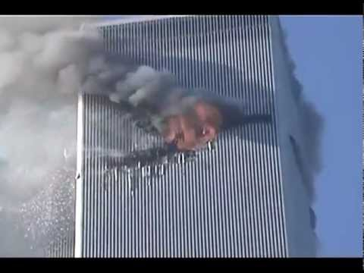

Slide 53
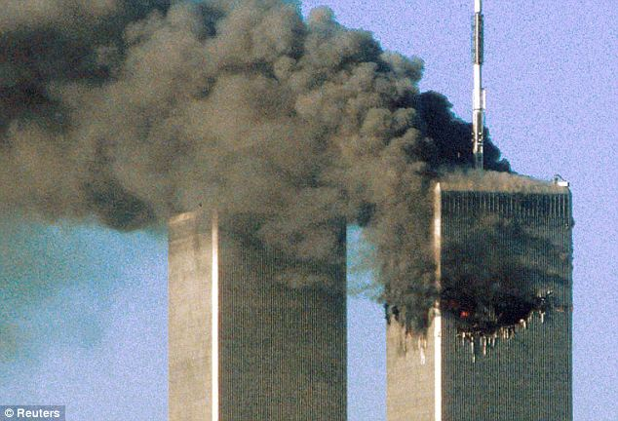
American Airlines Flight 11 crashes at roughly 466 mph (790 km/h or 219m/s or 425 knots) into the north face of the North Tower (1 WTC) of the World Trade Center, between floors 93 and 99. The aircraft enters the tower intact. It plows to the building's core, severing all three gypsum-encased stairwells, dragging combustibles with it. A powerful shock wave travels down to the ground and up again. The combustibles and the remnants of the aircraft are ignited by the burning fuel. As the building lacks a traditional full cage frame and depends almost entirely on the strength of a narrow structural core running up the center, fire at the center of the impact zone is in a position to compromise the integrity of all internal columns. People below the severed stairwells start to evacuate—no one above the impact zone is able to do so.

Slide 54
Human Casualties
Above the impact zone everyone is trapped
Many decide to jump or accidentally fall out of the windows above the impact zone, showing just how brutal the conditions were inside the tower
At least 200 people either jumped or fell out of the tower

Slide 55
Evacuation and Problems
WTC 1, or the North Tower, was the first of the Twin Towers to be completed, the first to be hit by a plane on September 11th, and the last to be destroyed.
Upon impact, fireballs and smoke emerged from the building. The impact rocked the tower, causing a horizontal deflection of perhaps 10 feet on the upper floors
Flight 11 was carrying an estimated 10,000 gallons of fuel at the time of impact. There is only one known video, and no known photographs, capturing the moment of impact and subsequent fireball development. It shows orange fireballs and torrents of smoke possibly obscuring fireballs emerging from the punctured north wall and the east wall.
The centered impact had embedded most of the plane in the tower's stout core, and fireballs fed by office air with atomized jet fuel spilled out of the punctured north wall and adjacent east wall. It is widely believed that most of the fuel remained inside the building and burned there. Unlike the South Tower impact, the only piece of plane documented to exit the North Tower was a small piece of landing gear (and supposedly a hijacker's passport).

Slide 56
For a few minutes after the impact fires could be seen on several floors, including most of the perimeter of one floor.
By the time the South Tower was hit, less fire was visible from the Building's north side, and the smoke had turned darker, apparently due to the exhaustion of the jet fuel.
As time progressed, the fires spread to new areas while burning out in others.
Photographs show significant expanses of fires near the windows on several floors prior to the tower's destruction. A span about 40 feet wide at the 104th floor of the northwest face showed large emergent flames starting about the time that the South Tower fell.

Slide 57
Evacuation and Rescue North tower
The evacuation of the North Tower proceeded efficiently from the time it was hit, via the three stairways. The elevators were all knocked out. The 102 minutes between the impact and collapse allowed the vast majority of its occupants below the crash zone to escape to safety.
No one on the 91st floor or above is believed to have survived. The New York Times estimated that 1,344 of the people in this zone perished. It is not clear how many remained alive until the collapse, but many parts of the upper floors filled which toxic smoke long before. In many cases people broke windows for fresh air. In one of the most horrifying spectacles of the attack, approximately 200 people jumped to their deaths, apparently to escape agonizing deaths from smoke inhalation.
At 10:07 a police helicopter radioed a warning for firefighters to evacuate the North Tower because the South Tower had just collapsed. Unfortunately most of the firefighters' radios did not work inside the towers, and few heard that or other orders to evacuate. 121 FDNY firefighters were killed when the North Tower collapsed. Another oversight, as they realized that radio communication was sketchy after the 1993 attack, but nothing was done about it

Slide 58
Collapse
Although this tower collapsed second, it was hit first so we will continue the discussion here…
The North Tower began its collapse at 10:28 AM. The collapse began in an instant, as the entire overhanging section of the tower began its telescoping plunge into the intact section.
Although no flames had been visible in the crash zone for some time, a second after the collapse began, large orange flames bellowed out from the collapse zone.
Within about two seconds, the exploding clouds of dust swallowed up the tower's top.

Slide 59
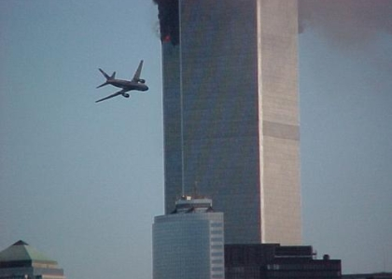

Slide 60
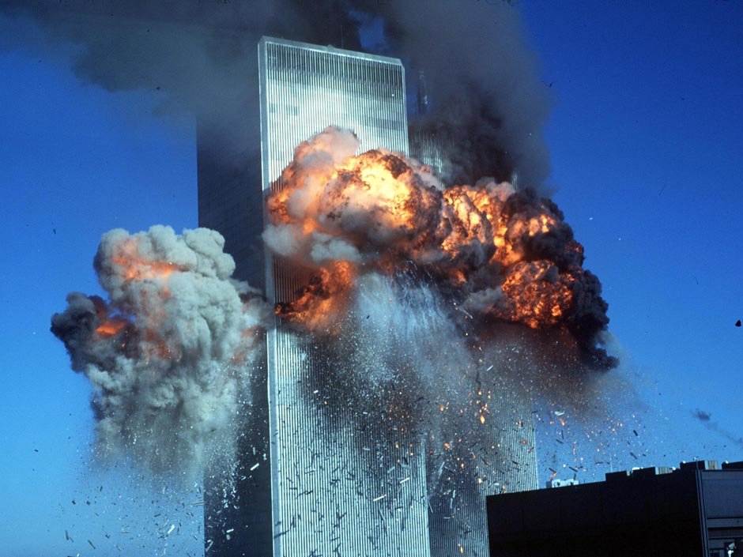

Slide 61
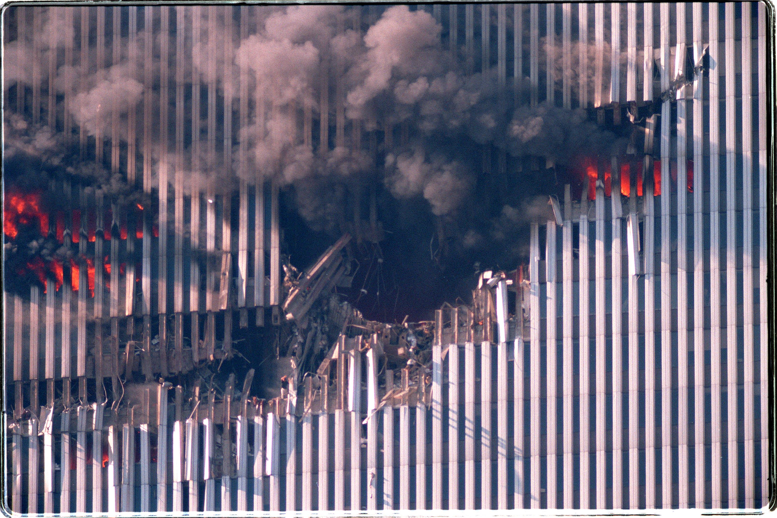

Slide 62
Flight 175 crashes at about 590 mph (950 km/h, 264 m/s or 513 knots) into the south face of the South Tower (2 WTC) of the World Trade Center, between floors 77 and 85. All 65 people on board the aircraft die instantly on impact, and unknown hundreds in the building as well. By this time, several media organizations, including the three major broadcast networks (who have interrupted their morning shows), are covering the first plane crash—millions see the impact live. Parts of the plane, including the starboard engine, leave the building from its east and north sides, falling to the ground six blocks away.
A massive evacuation begins in the South Tower below its impact zone. One of the stairwells in the South Tower remains unblocked from the top to the bottom of the tower because of the plane hitting at an offset from the vertical center line of the building, but it is filled with smoke. This leads many people to mistakenly go upwards towards the roof for a rooftop rescue that never comes. The Port Authority of New York and New Jersey kept the two sets of heavy metal doors leading to the building's only roof exit tightly locked.

Slide 63
2 WTC South Tower
WTC 2, or the South Tower, was the second of the Twin Towers to be completed, the second to be hit by a plane on September 11th, and the first to be destroyed.
At 9:03 AM, a jet, apparently Flight 175, slammed into the southwest face of the tower, creating an impact hole that extended from the 78th to 84th floors.
Upon impact, large fireballs emerged from the southwest, southeast, and northeast faces, and east corner.
The impact rocked the tower, causing it to sway several feet. The jet hit the right side of the face at an oblique angle, and much of the fuselage emerged from the east corner.
It appears that a large portion of the estimated 10,000 gallons of fuel Flight 175 was carrying at the time of impact exited the southeast and northeast faces of the building in the spectacular fireballs.
Seventeen minutes after the North Tower impact, a number of photographers were able to capture the South Tower fireballs on film

Slide 64
Fire
Immediately after the impact, flames were visible around the region of the impact.
Unlike the North Tower, in which some fires were visible well above the impact zone, the fires in the South Tower never spread beyond the impact zone.
In fact there is no evidence that the fires on the floors at the impact zone even spread to the opposite side of the building.
By the time the building collapsed, the fires appeared to be suffocating, as no flames were visible, and only black smoke was emerging.
At that time the vast majority of smoke was coming from the North Tower. New York firefighters reached the crash zone before the building broke up, and described "two pockets of fire".

Slide 65
Evacuation and Rescue
Evacuation of the South Tower started after the 8:46 jet collision with the North Tower. Since the elevators were still working fully between 8:46 and 9:03, evacuation proceeded more efficiently than in the North Tower. However there was confusion, such as that caused by the announcements over the PA system saying that the building was secure and people could return to their offices. Heeding that advice might have cost the lives of hundreds of people.
When the jet hit the South Tower, it cut off several routes of evacuating the 30 floors above the impact zone. It did leave at least one of the stairwells passable, and the New York Times found at least 18 people who escaped through that stairwell. Most people above the crash zone were not aware of the escape route, and at least 200 climbed toward the roof in hopes of being rescued there, only to find the doors to the roof locked. No one had told them that roof top rescue, which had been used in the 1993 bombing, was no longer an option

Slide 66
Destruction and Collapse
The South Tower began its collapse at 9:59 AM. At first the portion of the tower above the crash zone began to tilt to the southeast, while the first explosions of dust began at the crash zone. Then, at about 2.5 seconds the top began to fall, and its rotation decelerated. At about the 6.5-second mark, the top was completely swallowed up by the huge growing dust cloud.
In apparently spontaneous commentary, Peter Jennings indicated that the event looked like a controlled demolition by pointing out that access to the "underlying infrastructure" is required to bring down such a building. Thus spearing consequent conspiracy theories.
The sequences of destruction in WTC 1 and 2 looked very similar once the tops disappeared based on the surviving evidence.

Slide 67
WTC site Death Toll and Final 9/11 death toll
At the World Trade Center site in Lower Manhattan, 2,753 people are killed
Of those who perish during the initial attacks and the subsequent collapses of the towers, 343 are New York City firefighters, another 23 are New York City police officers and 37 others are officers at the Port Authority.
The victims range in age from two to 85 years. Approximately 75-80 percent of the victims are men.
AA #11- 92
UA #175- 65
Pentagon- 125 (55 military)
AA #77- 64
UA #93- 44
These totals do not include the hijackers

Slide 68
7 WTC
Many conspiracy theorists point to the later collapse of WTC 7 as evidence that 911 was an inside job because no plane hit it
Fact: The south face of WTC7 was slashed top to near bottom.
Fact: Barry Jennings, who claims it was an explosion) most likely witnessed the gash being made, not an explosion (this fact will be developed further).
The gash, Jennings’ location near the falling perimeter wall, and Jennings’ description of damage are corroborated and indisputable fact. How deep did the gash penetrate WTC7? All the way to the core?, Was there any other damage?, and Why does the gash matter?
The Barry Jennings story is what most controlled demolition proponents use as evidence of a controlled demolition.
In his account of events on 9/11/01 he saw explosions in the building. In trying to corroborate his story, however, experts in controlled demolition, like Joe Hill, found his time line did not add up, and his description of events fit more in line with a plummeting slab of WTC1 perimeter wall than any explosion. He was also in a dark, enclosed stairwell at the time of the events
The following information comes from Joe Hill’s research

Slide 69
The reason the line of the gash is cleanly vertical is because the piece of perimeter wall which did this damage was cradled between two columns as it fell, much like the edge of a sword. The nature of damage indicates the plane of the falling perimeter wall struck flat or at an angle, then turned sideways, and turned back to flat near the bottom.

Slide 70
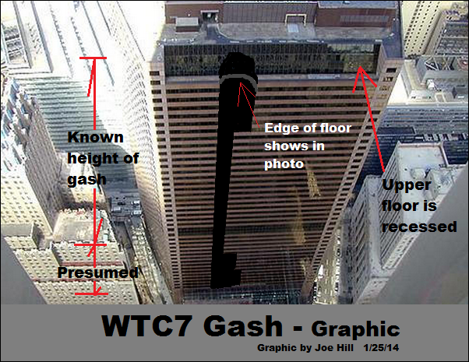

Slide 71
What does this gash mean?
There is no question the south face of WTC7 was severed top to at least the 23rd floor, and likely to near the bottom. Those 24 floors of perimeter wall breach alone would be fatal for the building
Controlled demolition proponents claim south face damage was minimal. These photos show damage to the building was fatal. Integrity of the perimeter wall, or “curtain”, in a large span design, is vital for lateral and diagonal stability.

Slide 72
The Attack on the Pentagon

Slide 73
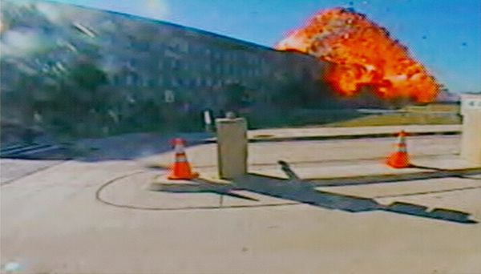

Slide 74
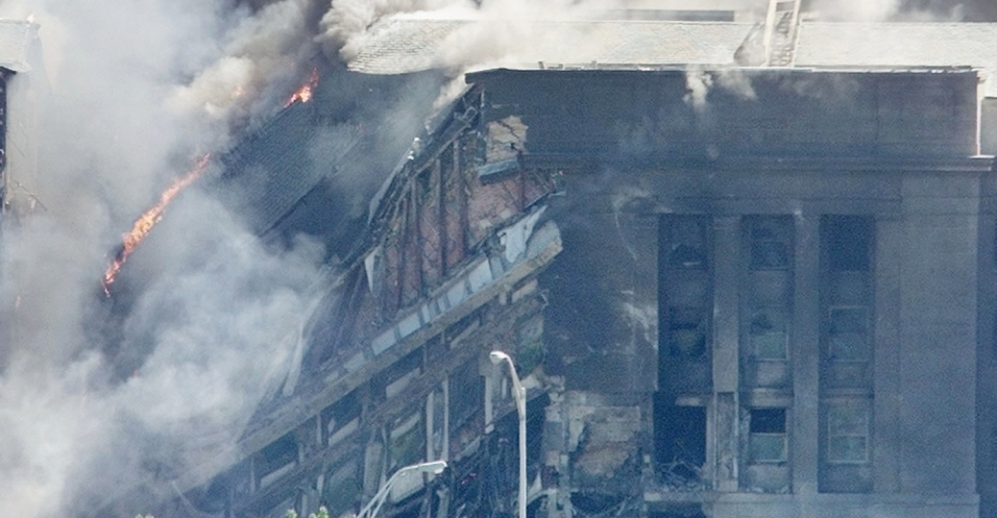

Slide 75
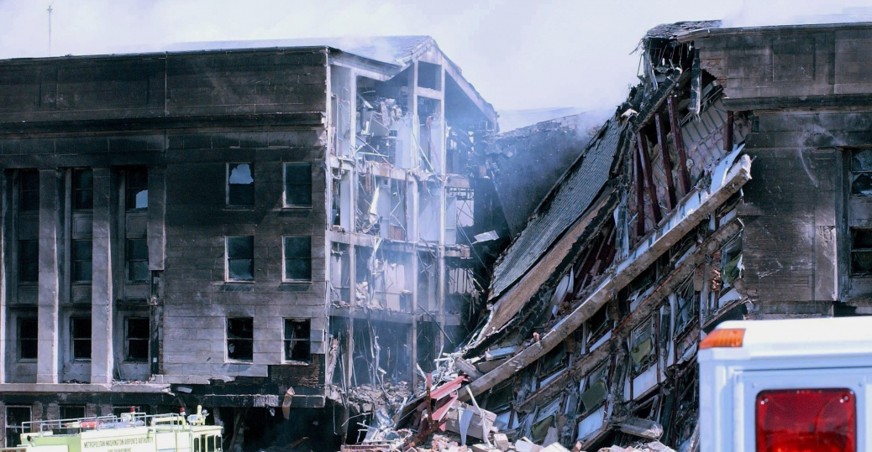

Slide 76
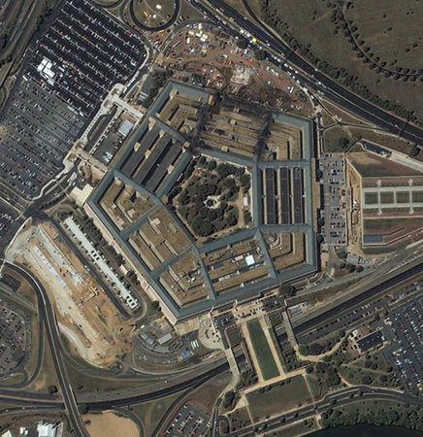

Slide 77
As millions watched the events unfolding in New York, American Airlines Flight 77 circled over downtown Washington, D.C., and slammed into the west side of the Pentagon military headquarters at 9:45 a.m.
Jet fuel from the Boeing 757 caused a devastating inferno that led to the structural collapse of a portion of the giant concrete building.
All told, 125 military personnel and civilians were killed in the Pentagon, along with all 64 people aboard the airliner.

Slide 78
United Airlines Flight 93
The passenger revolt began at 9:57 a.m., nearly 30 minutes after the four terrorists aboard launched their takeover of the Boeing 757 loaded with more than 11,000 gallons of jet fuel.
As passengers charged the cockpit door, terrorist hijacker Ziad Jarrah began rolling the plane to the left and right, "attempting to knock the passengers off balance," the 9/11 commission report said. Jarrah told another hijacker in the cockpit to block the door.
By 9:59 a.m., Jarrah changed tactics and "pitched the nose of the airplane up and down to disrupt the assault."
"The [flight] recorder captured the sounds of loud thumps, crashes, shouts and breaking glass and plates. At 10:00:03 a.m., Jarrah stabilized the airplane," the report says.

Slide 79
"Five seconds later, Jarrah asked, 'Is that it? Shall we finish it off?' A hijacker responded, 'No. Not yet. When they all come, we finish it off.'
Jarrah resumed pitching the plane up and down.
"In the cockpit. If we don't, we'll die," a passenger is heard saying.
"Sixteen seconds later, a passenger yelled, “Let’s Roll!' " the report says.
By 10:01 a.m., Jarrah stopped his violent maneuvers and said, "Allah is the greatest! Allah is the greatest!“
According to the report, he then asked another hijacker in the cockpit, "Is that it? I mean, shall we put it down?"
"Yes, put it in it, and pull it down," the other responded.

Slide 80
The passengers continued with their assault, trying to break through the cockpit door. At 10:02 a.m. and 23 seconds, a hijacker said, "Pull it down! Pull it down!"
"The hijackers remained at the controls but must have judged that the passengers were only seconds from overcoming them," the report concludes.
"The airplane headed down; the control wheel was turned hard to the right. The airplane rolled onto its back, and one of the hijackers began shouting, 'Allah is the greatest. Allah is the greatest.'
"With the sounds of the passenger counter-attack continuing, the aircraft plowed into an empty field in Shanksville, Pennsylvania, at 580 miles per hour, about 20 minutes' flying time from Washington, D.C.“
There were 33 passengers and 7 crew members on board (not including the 4 hikjackers)

Slide 81
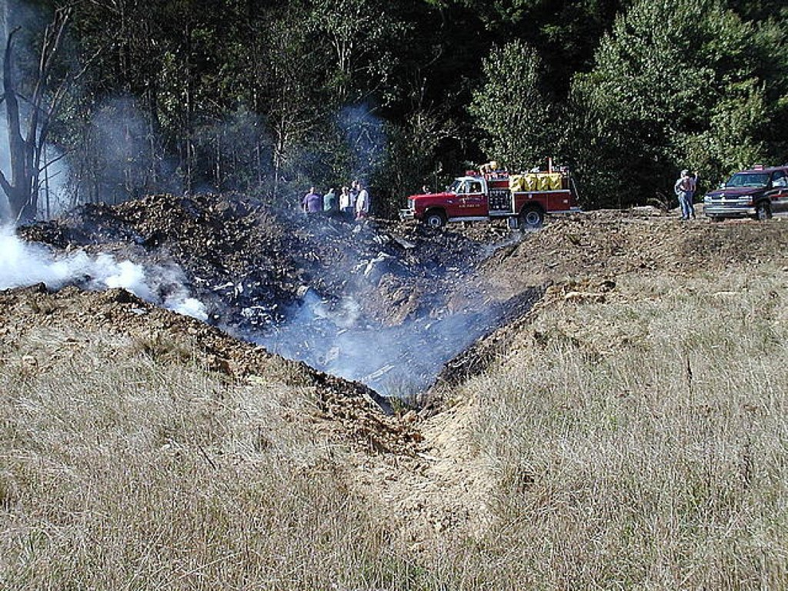

Slide 82
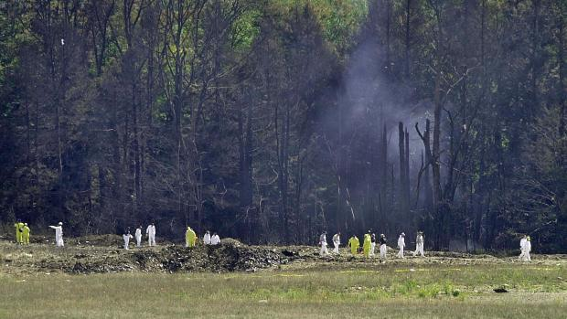

Slide 83
